Slide 1
For Information
SHUSA RAS METRICS
Interest Rate Risk and Liquidity Risk Management
April 25, 2016
Manuel Lasso, Chief Market Risk Officer
Final Version

Slide 2
Agenda
1
Executive Summary
2
Operating Limits Control
3
IRR & Liquidity Risk Exposure
4
Market Risk Outlook
5
Appendix
Management Updates

Slide 3
Statements: Interest Rate & Liquidity Risk
As of January 31, 2016
# | Risk type |  | Statement
1 | Interest Rate Risk |  | We will conservatively manage our Market Risk exposures, setting a maximum for the sensitivity of market value of equity to interest rates. We will hedge via instruments that we understand to minimize our exposure to Interest Rate Risk. We will not participate in proprietary trading and will always maintain a low trading risk profile. The risk appetite should be calibrated in terms of both risk to economic value and risk to earnings. Measurement of IRRBB should be based on outcomes for both economic value and earnings arising from a wide and appropriate range of interest rate shock scenarios that result in changes to interest rates across the term structure.
2 | Liquidity |  | We will guarantee a control over the buffer and healthy level of high liquid assets We will establish a minimum level in which to manage liquidity and will retain a strong capability to fund based on stress test results and regulatory standards We will raise observations and challenge the liquidity stress test exercise when is appropriate We will oversight compliance of regulatory standards and corporate definitions for Liquidity Risk Management We will have sufficient High Quality Liquid Assets and an effective Contingency Funding Plan to withstand liquidity shortfalls a severe stress scenario We will establish a funding strategy to diversify funding sources and minimize our dependence on capital markets The liquidity risk management framework will comprehensively control and report risk exposures.
MVE -200bps down shock currently suspended, final RAS metric considers the worst between down 100 and up 200.
All Amounts are in USD $MM unless otherwise specified.

Slide 4
2016 SHUSA Limits Proposal
SHUSA Balance Sheet: 2016 Projected
Book Perimeter: Balance Sheet Management
Risk Types: Interest Rate Risk (IRR) & Liquidity Risk (LR)
Risk Type | Core Metric | Current Exp. | Current RAS | 1st LOD Proposal | 2nd LOD Proposal | Global Constraints | Comments
IRR | MVE +/- 100 Shocks | -1,220mm | -1,220mm | <= -7.5% [≈-1,458mm] | <= -7.0% [≈-1,360mm] | EBA Riskier Rating: -7.5% | Today SHUSA has max. historical exposure because low rate environ.
IRR | NII +/- 100 Shocks | -140mm | -140mm | <= -7.5% [≈-452mm] | <= -3.5% [≈-211mm] | EBA Riskier Rating: -3.5% | SBNA contributes more; Historically , exposure has been < than -$120mm
LR | Structural Funding Ratio (SFR) | 100% | 100% | <= 100% | OK | 100% Mn | -
LR | Liquidity Coverage Ratio (LCR) - EUR | 125% | 125% | <= 105% | OK | 100% Mn | Global requests to include European rules
LR | Liquidity Coverage Ratio Modified (LCRM) – USA | 125% | 125% | <= 105% | OK | - | Treasury wants to keep US approach
LR | Liquidity Stress Test (LST) Survival Period | 60 days | 60 days | <= 60 days | OK | <90 ds | -
LR | Wholesale Scenario (SHUSA PO) | 90 DAYS | 90 DAYS | <= 6 mths | OK | <90 ds (At the consol. level) | Global is opened to consolidate considering trap liquidity
LR | Assets Encumbrance Ratio | NA | NA | TBD (At the SBNA level only) | >= 55% (Full SHUSA) | 25% Mx | SC dependency on secured funding + 25% limit on SBNA

Slide 5
RAS Metrics Proposal
TREASURY PROPOSAL
SHUSA RAS
RAS Escalation
Book Perimeter | Risk Type | Core Metric | Current RAS | Proposed RAS | Amber | Green | Operat. Guideline
Balance Sheet Management | Interest Rate Risk | MVE +/- 100 Shocks | -1,220mm | <= -7.5% [≈-1,458mm] | <=-6.5% [≈-1,263mm] | > -6.5% | <= -5.5% [≈-1,069mm]
Balance Sheet Management | Interest Rate Risk | NII +/- 100 Shocks | -140mm | <= -7.5% [≈-452mm] | <= -5.0% [≈-302mm] | > -5.0% | <= -4.0% [≈-241mm]
Balance Sheet Management | Liquidity | Structural Funding Ratio (SFR) | 100% | <= 100% | <=103% | > 103% | <= 104%
Balance Sheet Management | Liquidity | Liquidity Coverage Ratio (LCR) - EUR | 125% | <= 105% | <=115% | > 115% | <= 125%
Balance Sheet Management | Liquidity | Liquidity Coverage Ratio Modified (LCRM) – USA | 125% | <= 105% | <=115% | > 115% | <= 125%
Balance Sheet Management | Liquidity | Liquidity Stress Test (LST) Survival Period | 60 days | <= 60 days | <= 70 days | > 70 days | <= 90 days
Balance Sheet Management | Liquidity | Wholesale Scenario (SHUSA PO) | 90 DAYS | <= 6 mths | <= 12 mths | > 12 mths | <= 24 mths
Balance Sheet Management | Liquidity | Assets Encumbrance Ratio | NA | TBD | TBD | TBD | TBD
A threshold activating yellow status should be considered as Operating Limit. This will implies a recalibration to the Operating Limits.

Slide 6
RAS Metrics Proposal
MARKET RISK PROPOSAL
SHUSA RAS
RAS Escalation
Book Perimeter | Risk Type | Core Metric | Current RAS | Proposed RAS | Amber | Green | Operat. Guideline
Balance Sheet Management | Interest Rate Risk | MVE +/- 100 Shocks | -1,220mm | <= -7.0% [≈-1,360mm] | <=-6.5% [≈-1,263mm] | > -6.5% | <= 5.5% [≈-1,069mm]
Balance Sheet Management | Interest Rate Risk | NII +/- 100 Shocks | -140mm | <= -3.5% [≈-211mm] | <= -3.0% [≈-181mm] | > 3.0% | <= 2.5% [≈-150mm]
Balance Sheet Management | Liquidity | Structural Funding Ratio (SFR) | 100% | <= 100% | <=103% | > 103% | <= 104%
Balance Sheet Management | Liquidity | Liquidity Coverage Ratio (LCR) - EUR | 125% | <= 105% | <=115% | > 115% | <= 125%
Balance Sheet Management | Liquidity | Liquidity Coverage Ratio Modified (LCRM) – USA | 125% | <= 105% | <=115% | > 115% | <= 125%
Balance Sheet Management | Liquidity | Liquidity Stress Test (LST) Survival Period | 60 days | <= 60 days | <= 70 days | > 70 days | <= 90 days
Balance Sheet Management | Liquidity | Wholesale Scenario (SHUSA PO) | 90 DAYS | <= 6 mths | <= 12 mths | > 12 mths | <= 24 mths
Balance Sheet Management | Liquidity | Assets Encumbrance Ratio | NA | >= 55% | >= 50% | < 50% | >= 46%
A threshold activating yellow status should be considered as Operating Limit. This will implies a recalibration to the Operating Limits.

Slide 7
RAS Metrics Proposal
TREASURY PROPOSAL
Santander Bank N.A. (SBNA)
Book Perimeter | Risk Type | Core Metric | Current RAS | Proposed RAS | Amber | Green | Operat. Guideline
Balance Sheet Management | Interest Rate Risk | MVE +/- 100 Shocks | (1,100) [≈-10.2%] | <= -12.0% | <=-11.0% | > -11.0%
Balance Sheet Management | Interest Rate Risk | NII +/- 100 Shocks | (200) [≈-10.5%] | <= -12.0% | <=-10.0% | > -10.0%
Balance Sheet Management | Liquidity | Structural Funding Ratio (SFR) | 100% | <= 100% | <=103% | > 103%
Balance Sheet Management | Liquidity | Liquidity Coverage Ratio Modified (LCRM) - USA | 110% | <= 100% | <=105% | > 105%
Balance Sheet Management | Liquidity | Liquidity Stress Test (LST) Survival Period | 60 days | <= 60 days | < 70 days | > 70 days
Balance Sheet Management | Liquidity | Assets Encumbrance Ratio | NA | TBD | TBD | TBD
Balance Sheet Management | Liquidity | Loan to Deposit Ratio | NA | >= 120% | >= 110% | < 110%
A threshold activating yellow status should be considered as Operating Limit. This will implies a recalibration to the Operating Limits.

Slide 8
RAS Metrics Proposal
MARKET RISK PROPOSAL
Santander Bank N.A. (SBNA)
Book Perimeter | Risk Type | Core Metric | Current RAS | Proposed RAS | Yellow | Green | Operat. Guideline
Balance Sheet Management | Interest Rate Risk | MVE +/- 100 Shocks | (1,100) [≈-10.2%] | <= -10.0% | <=-9.0% | > -9.0%
Balance Sheet Management | Interest Rate Risk | NII +/- 100 Shocks | (200) [≈-10.5%] | <= -11.0% | <=-10.0% | > -10.0%
Balance Sheet Management | Liquidity | Structural Funding Ratio (SFR) | 100% | <= 100% | <=103% | > 103%
Balance Sheet Management | Liquidity | Liquidity Coverage Ratio Modified (LCRM) - USA | 110% | <= 100% | <=105% | > 105%
Balance Sheet Management | Liquidity | Liquidity Stress Test (LST) Survival Period | 60 days | <= 60 days | < 70 days | > 70 days
Balance Sheet Management | Liquidity | Assets Encumbrance Ratio | NA | >= 30% | >= 26% | < 26%
Balance Sheet Management | Liquidity | Loan to Deposit Ratio | NA | >= 120% | >= 110% | < 110%
A threshold activating yellow status should be considered as Operating Limit. This will implies a recalibration to the Operating Limits.

Slide 9
RAS Metrics Proposal
SHUSA TREASURY & MARKET RISK PROPOSAL
Santander Consumer (SC)
Book Perimeter | Risk Type | Core Metric | Current RAS | Proposed RAS | Amber | Green
Balance Sheet Management | Interest Rate Risk | NII +/- 100 Shocks | - $100mm | <= -2.5% [≈-100mm] | <= -2.0% [≈-80mm] | > -2.0%
Balance Sheet Management | Interest Rate Risk | MVE +/- 100 Shocks | -$300mm (at 200bps) | <= -3.5% [≈-175mm] | <= -2.8% [≈-140mm] | > -2.8%
Balance Sheet Management | Liquidity | Structural Funding Ratio (SFR) | 70% | <= 70% | <= 75% | > 75%
Balance Sheet Management | Liquidity | SC - Available Committed Liquidity | 5 mths | <= 3 mths | <= 4 mths | > 4 mths
A threshold activating yellow status should be considered as Operating Limit. This will implies a recalibration to the Operating Limits.

Slide 10
RAS Metrics Proposal
SANTANDER BANCORP - PUERTO RICO
Book Perimeter | Risk Type | Core Metric | Current RAS | Proposed RAS | Amber | Green
Balance Sheet Management | Interest Rate Risk | NII +/- 100 Shocks | -15mm [≈-7.7%] | <= -5.0% | <=-3.0% | > -3.0%
Balance Sheet Management | Interest Rate Risk | MVE +/- 100 Shocks | -55mm [≈-7.8%] | <= -4.5% | <=-3.5% | > -3.5%
Balance Sheet Management | Liquidity | Structural Funding Ratio (SFR) | 100% | <= 102% | <=104% | > 104%
Balance Sheet Management | Liquidity | Liquidity Stress Test (LST) Survival Period | 60 days | <= 60 days | < 90 days | > 90 days

Slide 11
RAS Metrics Proposal
Banco Santander Internacional (BSI)
Book Perimeter | Risk Type | Core Metric | Current RAS | Proposed RAS | Amber | Green
Balance Sheet Management | Interest Rate Risk | NII +/- 100 Shocks | -16mm [≈-18.8%] | <= -27.0% | <=-21.0% | > -21.0%
Balance Sheet Management | Interest Rate Risk | MVE +/- 100 Shocks | -31mm [≈-3.4%] | <= -3.5% | <= -2.5% | > -2.5%
Balance Sheet Management | Liquidity | Structural Funding Ratio (SFR) | 100% | <= 100% | <=121% | > 121%
Balance Sheet Management | Liquidity | Liquidity Stress Test (LST) Survival Period | na | <= 60 days | < 90 days | > 90 days
Balance Sheet Management | Liquidity | Liquidity Coverage Ratio (LCR) - EUR | 100% | Removed | Removed | Removed
A threshold activating yellow status should be considered as Operating Limit. This will implies a recalibration to the Operating Limits.

Slide 12
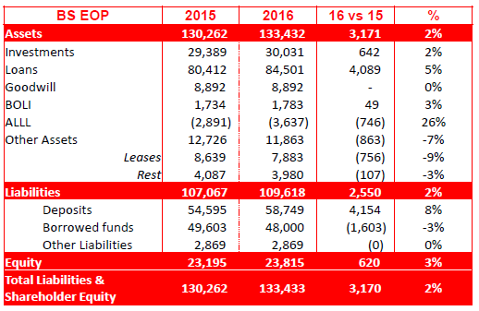
2016 SHUSA Limits Proposal
SHUSA Balance Sheet: 2016 Projected
SHUSA consolidated BS grows 2%: SBNA flat, Santander Consumer grows slightly while Holdco builds balance of liquidity buffer on behalf of SCUSA
Strategic Plan – P18, 2016 considerations:
Investment portfolio would increase to $26bn, keep existing $20bn at SBNA and new $6bn at SHUSA
2016-2018 customer deposit growth driven by Consumer, Commercial and Business Banking, outpaces loan & lease growth by $600mm
SC BS stable along 2016, but increasing up to $41.6Bn in 2018. 43% of the growth driven mostly by higher penetration rates in the Chrysler.
Market Context:
Original Projected Prepayment rates decreasing: due to rate increases.
Current Rate environment continue low keeping high prepayment levels
(Amounts in $bn)

Slide 13
2016 SHUSA Limits Proposal
SHUSA Interest Rate and Liquidity Risk: Exposure Projection
IRR exposure remains on pressure in the downside shocks
Considering worst projected conditions by each of the entities, stress conditions and model calibrations, worst exposure get closer to $1.1bn for MVE and $275mm for NII
However, for the case of NII, limit is currently capped by RAS of $130mm

Slide 14
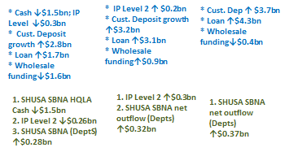
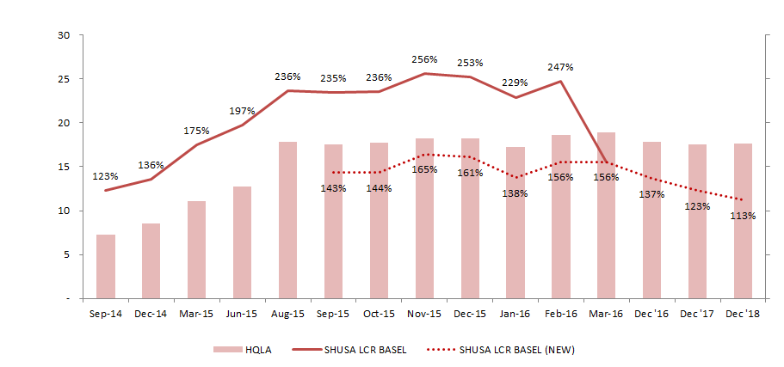
2016 SHUSA Limits Proposal
SHUSA Interest Rate and Liquidity Risk: Liquidity Coverage Ratio*
Forecasts are based upon November 2015 iteration of Budget Forecast (P-18).
LCR projected downward due to flattening of HQLA and increase in unstable deposit outflow
Dec 2016 Dec 2017 Dec 2018
ALCO Budget Strategies (Nov 2015)
Budget Strategies' Impact on LCR (Nov 2015)
*SHUSA LCR Basel (New) considers mapping to new data sources that have improved the accuracy of the calculation of the metric

Slide 15
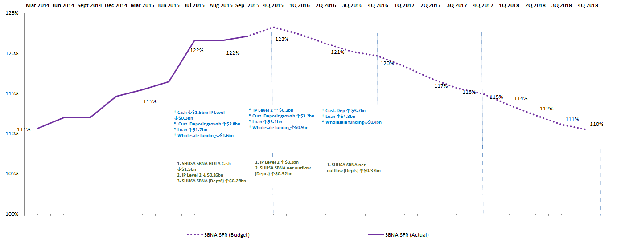
2016 SHUSA Limits Proposal
SHUSA Interest Rate and Liquidity Risk: Structural Funding Ratio
SFR metric for SBNA trends relatively flat with little impact from SC based upon Strategic Plan
SBNA Strategic Plan indicates that the changes in the wholesale funding position will net during 2016 – 2018 while exhibiting modest growth in the loan portfolio.
As such, the SFR ratio trends down to 110% at the end of 2018 from 120% range in 2016.

Slide 16
2016 SHUSA Limits Proposal
SHUSA Interest Rate and Liquidity Risk: Asset Encumbrance
Asset Encumbered Ratio measures the percentage of assets used to obtain funding or encumbered for other operations (e.g. derivatives, collateral, guarantees, etc.).
SHUSA has a large Asset Encumbered Ratio mainly attributed to its subsidiary SC, which has almost all (89%) of its assets encumbered: $28.1BN of assets collateralizing securitizations and $8.7BN of assets collateralizing warehouse lines.
SHUSA’s other main subsidiary (SBNA) also impacts this ratio with the main driver being $17BN of assets collateralizing FHLB.
The asset encumbrance funding profile of the businesses have stayed fairly consistent for Q4 2015 and Q1 2016.
Inclusion of IHC entities (that have little or no encumbrance) is estimated to increase Total Assets by $12BN.
A change in the structural characteristics of the balance sheet - heavily dependent on securitizations, warehouse lines, and FHLB funding - is not considered in the current funding plan.
December 2015
March 2016
 |  | Encumbered Assets |  | Total Assets (incl. off-B/S) |  | Asset Encumbrance Ratio
SBNA |  | 26.2 |  | 87.8 |  | 29.8%
SC |  | 35.5 |  | 40.1 |  | 88.6%
SHUSA |  | 61.7 |  | 127.9 |  | 48.3%
 |  | Encumbered Assets |  | Total Assets (incl. off-B/S) |  | Asset Encumbrance Ratio
SBNA |  | 28.4 |  | 90.0 |  | 31.5%
SC |  | 36.8 |  | 41.3 |  | 89.0%
SHUSA |  | 65.2 |  | 131.3 |  | 49.6%

Slide 17
RTS
Metrics Change
Strategic
Reputational
Credit
Market
Liquidity
Operational
Compliance
Model
Capital
17
Interest Rate Risk: NII +/-100
Current
 |  |  |  |  |  | Early Warning Indicators
Risk Type | Quantitative Measure | Limit |  | Red |  | Yellow | Green
Market | Net interest income (NII) (+/-100bps) | <($140)MM |  | <($140)MM |  | <($120)MM | >($120)MM
Proposed
 |  |  |  |  |  | Early Warning Indicators
Risk Type | Quantitative Measure | Limit |  | Red |  | Amber | Green
Market | Net interest income (NII) (+/-100bps) | -3.5% [-$211mm] |  | <-3.5% [-$211mm] |  | <-3.0% [-$181mm] | >-3.0% [-$181mm]
Rationale for the new proposal:
The 2016 limits will apply at the consolidated SHUSA level, including SBNA and SC. The level of the metrics represent the maximum exposure from the risk related to current activity and new businesses defined by the strategic plan, market rate environment and stress conditions.

Slide 18
RTS
Metrics Change
Strategic
Reputational
Credit
Market
Liquidity
Operational
Compliance
Model
Capital
18
Interest Rate Risk: MVE +/-100
Current
 |  |  |  | Early Warning Indicators
Risk Type | Quantitative Measure | Limit | Red | Yellow | Green
Market | Market value of equity (MVE) (+/-200bps) | <($1,220)mm | <($1,220)mm | <($1,070)mm | >($1,070)mm
Proposed
 |  |  |  | Early Warning Indicators
Risk Type | Quantitative Measure | Limit | Red | Amber | Green
Market | Market value of equity (MVE) (+/-100bps) | -7.0% [-$1,360mm] | <-7.0% [-$1,360mm] | <-6.5% [-$1,263mm] | >-6.5% [-$1,263mm]
Rationale for the new proposal:
The 2016 limits will apply at the consolidated SHUSA level, including SBNA and SC. The level of the metrics represent the maximum exposure from the risk related to current activity and new businesses defined by the strategic plan, market rate environment and stress conditions.

Slide 19
RTS
Metrics Change
Strategic
Reputational
Credit
Market
Liquidity
Operational
Compliance
Model
Capital
19
Liquidity Risk: Structural Funding Ratio (SFR)
Current
 |  |  |  | Early Warning Indicators
Risk Type | Quantitative Measure | Limit | Red | Yellow | Green
Liquidity | Structural Funding Ratio | 100% | 100% | 105% | >105%
Proposed
 |  |  |  | Early Warning Indicators
Risk Type | Quantitative Measure | Limit | Red | Amber | Green
Liquidity | Structural Funding Ratio | 100% | <100% | <103% | >103%
Rationale for the new proposal:
Recalibrating early warning indicators. This metric serves as a measurement of long term liquidity risk exposure. Ideally is expected that source of funding are able to cover more than total utilization of funds.

Slide 20
RTS
Metrics Change
Strategic
Reputational
Credit
Market
Liquidity
Operational
Compliance
Model
Capital
20
Liquidity Risk: Liquidity Coverage Ratio (LCR)
Current
 |  |  |  | Early Warning Indicators
Risk Type | Quantitative Measure | Limit | Red | Yellow | Green
Liquidity | Liquidity Coverage Ratio (LCR) | 125% | <125% | <140% | >140%
Proposed
 |  |  |  | Early Warning Indicators
Risk Type | Quantitative Measure | Limit | Red | Amber | Green
Liquidity | Liquidity Coverage Ratio (LCR) | 105% | <105% | <115% | >115%
Rationale for the new proposal:
Recalibrating limits and early warning indicators LCR determines the amount of high quality assets that are available to cover the net position resulting from the amount of inflows received and the outflows to expected to pay in the next 30 days, factored by regulatory definitions.

Slide 21
RTS
Metrics Change
Strategic
Reputational
Credit
Market
Liquidity
Operational
Compliance
Model
Capital
21
Liquidity Risk: Liquidity Stress Test Survival Period
Current
 |  |  |  | Early Warning Indicators
Risk Type | Quantitative Measure | Limit | Red | Yellow | Green
Liquidity | Liquidity Stress Test Survival Period | 60 days | < 60 days | < 90 days | > 90 days
Proposed
 |  |  |  | Early Warning Indicators
Risk Type | Quantitative Measure | Limit | Red | Amber | Green
Liquidity | Liquidity Stress Test Survival Period | 60 days | < 60 days | < 70 days | > 70 days
Rationale for the new proposal:
The Liquidity Stress Test Survival period is the result of the worst scenario result prepared under stress conditions. Usually there scenarios related to idiosyncratic, market and combined events. The assumptions and model support rely in an iterative process between business lines and risk management. Santander has implemented the Liquidity Standard Program to enhance its Liquidity Risk Management. With this program, Santander has increased the amount of High Quality Assets, improving its position in the survival period under stress. Based on current stress test exercises performed by each of the individual entities, Santander would satisfy Risk Appetite levels defined.

Slide 22
RTS
Metrics Change
Strategic
Reputational
Credit
Market
Liquidity
Operational
Compliance
Model
Capital
22
Liquidity Risk: Asset Encumbrance (AC%)
Current
 |  |  |  | Early Warning Indicators
Risk Type | Quantitative Measure | Limit | Red | Yellow | Green
Liquidity | Asset Encumbrance (AC%) | na | na | na | na
Proposed
 |  |  |  | Early Warning Indicators
Risk Type | Quantitative Measure | Limit | Red | Amber | Green
Liquidity | Asset Encumbrance (AC%) | 55% | > 55% | > 50% | < 50%
Rationale for the new proposal:
The limit level is appropriate once considers the nature of the activity of the subsidiaries of SHUSA. Santander Consumer business inherently depends on secured funding, and almost all their funding is collateralized. This implies that from a total of assets of $+/- 130bn, at least 20% of the assets will be pledged. The additional 20% would represent the additional utilization that SBNA can potentially add.

Slide 23
RTS
Metrics Change
Strategic
Reputational
Credit
Market
Liquidity
Operational
Compliance
Model
Capital
23
Liquidity Risk: Loan To Deposit Ratio (LTD)
Current
 |  |  |  | Early Warning Indicators
Risk Type | Quantitative Measure | Limit | Red | Yellow | Green
Liquidity | Loan to Deposit Ratio | na | na | na | na
Proposed
 |  |  |  | Early Warning Indicators
Risk Type | Quantitative Measure | Limit | Red | Amber | Green
Liquidity | SBNA Loan to Deposit Ratio | 120% | > 120% | > 110% | < 110%
Rationale for the new proposal:
The RAS level is in line with Santander core objective, applying a level that creates incentives to self-fund the commercial and retail banking business.

Slide 24
RTS
Metrics Change
Strategic
Reputational
Credit
Market
Liquidity
Operational
Compliance
Model
Capital
24
Liquidity Risk: SC – Available Committed Liquidity (ACL)
Current
 |  |  |  | Early Warning Indicators
Risk Type | Quantitative Measure | Limit | Red | Yellow | Green
Liquidity | Available Committed Liquidity (ACL) | 5 mths | < 5 mths | < 6 mths | > 6 mths
Proposed
 |  |  |  | Early Warning Indicators
Risk Type | Quantitative Measure | Limit | Red | Yellow | Green
Liquidity | SC Available Committed Liquidity (ACL) | 3 mths | < 3 mths | < 5 mths | > 5 mths
Rationale for the new proposal:
The Available Committed Liquidity metric is a metric directly defined by SC in their RAS. SHUSA includes this metric as part of their RAS to recognize the importance of this metric. In addition, this metric replaces a formal liquidity stress test survival period in their RAS, and SHUSA incorporates this metrics in its set of RAS metrics for a direct monitoring at the Board level.

